Slide 1
React Fundamentals
Crash Course

Slide 2

Contents To Watch Out For
Before We Begin
Understanding Files And Folders
What’s React?
What Is A Component?
Why Learn React?
Function Components
Setup
Creating A New Component
Creating A New React App

Slide 3
Contents To Watch Out For
Default And Named Exports
Conditional Rendering
JSX
List Rendering
States And Props
Styling
Hooks At A Glance
Forms
Event Handling
HTTP GET And POST Requests
Parent Child Communication
Further Learning

Slide 4
Before We Begin
</> | This course is for complete beginners
</> | HTML, CSS and modern JavaScript are prerequisites
</> | Focus is on React concepts for a beginner
</> | React 18 will be used

Slide 5
What’s React?
</> | React is an open-source JavaScript library for building user interfaces
</> | React has a rich eco system and plays well with other libraries and is more than capable of building enterprise scale web applications

Slide 6
Why React?
</> | One of the most popular UI libraries and is well known in the job market
</> | React has a great community behind it
</> | React has a component-based architecture
</> | React is declarative

Slide 7
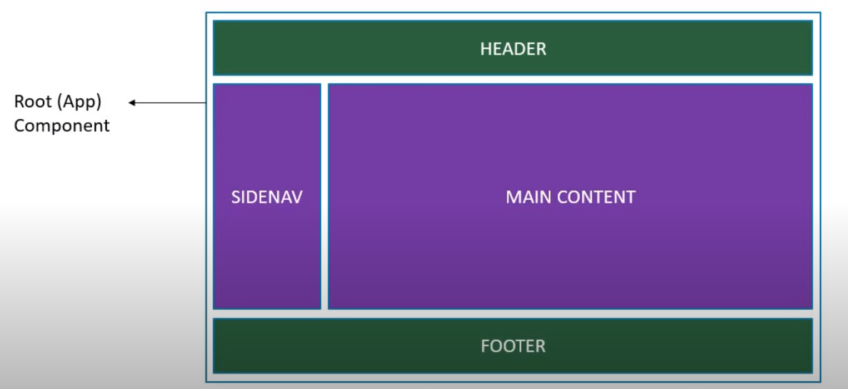
Components

Slide 8
Components continued…
</> | Components is a concept that helps to enforce the single-responsibility principle in React.
</> | We should think of components as reusable pieces of our application, where each one performs (ideally) exactly one responsibility/task.
</> | A Component is considered as the core building blocks of a React application which makes the task of building UIs much easier.
</> | Components let you split the UI into independent, reusable pieces, and think about each piece in isolation.
</> | Conceptually, components are like JavaScript functions. They accept arbitrary inputs (called “props”) and return React elements describing what should appear on the screen.

Slide 9
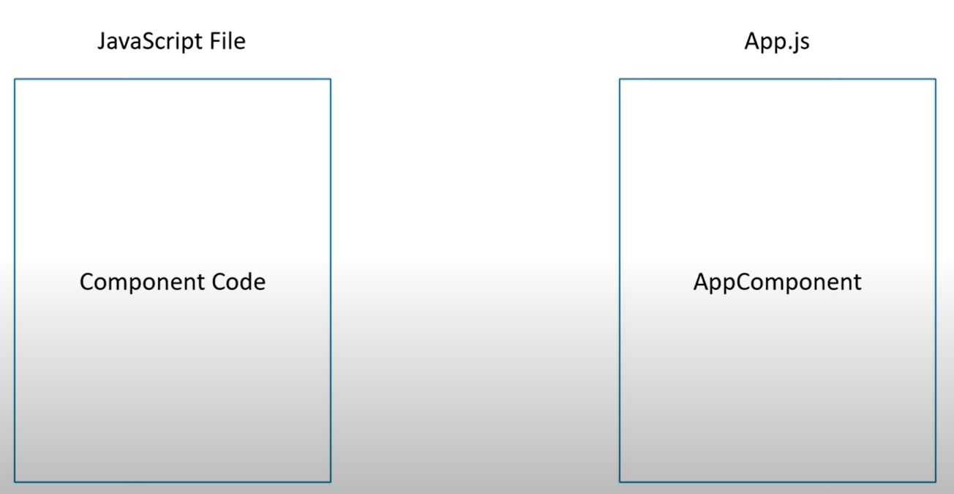
Component In Code

Slide 10
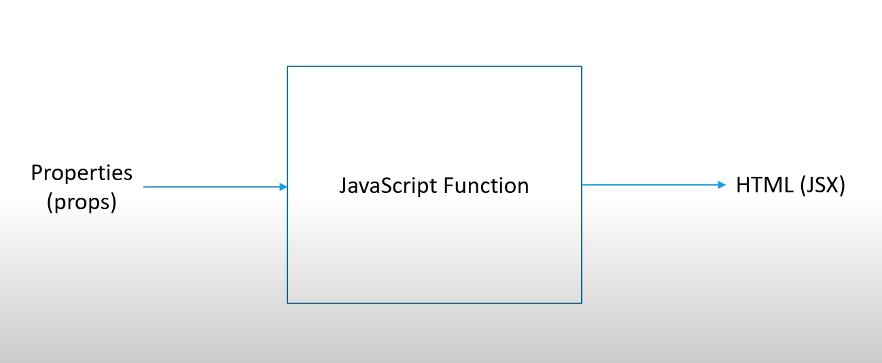
Function Components

Slide 11
JSX
What Is JSX?
</> | JSX Stands For JavaScript XML.
</> | JSX Allows Us To Write HTML In React.
</> | JSX Makes It Easier To Write And Add HTML In React.
const element = <h1>Hello, World! 👋</h1>;
const myElement = <h1>React is {5 + 5} times better with JSX</h1>;
The above code snippet is called JSX, and it is a syntax extension to JavaScript language syntax.

Slide 12
JSX Differences
</> | Class -> className
</> | For -> htmlFor
</> | camelCase property naming convention Onclick -> onClick Tabindex -> tabIndex

Slide 13
States And Props
Props
</> | The props is short for properties, and they are used to pass data between React components. Reacts data flow between components is unidirectional (from parent to child only).
</> | Props are immutable so we cannot modify the props from inside the component. We use props to pass data from parent component to child component and child component can't change its value as it is immutable and owned by the parent component.
</> | React props are like function arguments in JavaScript and attributes in HTML.

Slide 14
States And Props continued…
To send props into a component, we use the same syntax as HTML attributes:
const element = <Welcome name=“Mayur" />;
The component receives the argument as a props object and use the props.name attribute in the component to access the name value

Slide 15
States And Props continued…
States
</> | The state is a built-in object in React components. In the state object, we store property values that belong to the component.
</> | When the state object changes, the component re-renders.
</> | The props serve a similar purpose to the state. Both are plain JavaScript objects. The difference between them is that props get passed to the component whereas the state is managed within the component.

Slide 16
Hooks At A Glance
useState
useCallback
useReducer
useTransition
useEffect
useDefferedValue
useContext
useRef
useMemo

Slide 17
Conditional Rendering
In React, you can create distinct components that encapsulate behavior you need. Then, you can render only some of them, depending on the state of your application.
Conditional rendering in React works the same way conditions work in JavaScript.
Use JavaScript operators like if or the conditional operator to create elements representing the current state and let React update the UI to match them.
Consider these two components:
function UserGreeting(props) {
return <h1>Welcome back!</h1>;
}
function GuestGreeting(props) {
return <h1>Please sign up.</h1>;
}

Slide 18
Conditional Rendering continued…
We’ll create a Greeting component that displays either of these components depending on whether a user is logged in:
function Greeting(props) {
const isLoggedIn = props.isLoggedIn;
if (isLoggedIn) {
return <UserGreeting />;
}
return <GuestGreeting />;
}
This example renders a different greeting depending on the value of isLoggedIn prop.

Slide 19
Styling React Components
</> | CSS Stylesheets
</> | Inline Styling
</> | CSS Modules
</> | CSS In JS Libraries

Slide 20
Further Learning
</> | React Roadmap for 2024
</> | React Playlist

Slide 21
Ask Me Anything - Your Queries, Our Answers
No question is too big or too small.
Feel free to ask about React, web development, or anything else you're curious about.

Slide 22
Thank You!
Presented By: Mayur Pai

